Slide 1
Unit 2 – Part 3
Care of patients with Alzheimer's disease, immobile/semi or un-conscious patients, geriatrics suffering with dementia & its different manifestations.

Slide 2
Aging and illnesses like Alzheimer’s
In normal aging, there occurs reduction in the speed of mental processes and difficulty in learning new tasks.
Recall is also affected. But such changes do not interfere with the person’s personal, social or occupational life, as happens in dementia.
Recent studies suggest that cognitive decline is not a normal consequence of aging.
It has been observed on longitudinal study that subjects who eventually develop dementia of Alzheimer’s type show quite normal cognitive performance on the test battery over a period of years but then show a sharp downturn in performance.
Secondly in cognitive functions, memory is the key to the self, providing us with our sense of who we are, when that has gone, where is the self and the person’s personality is totally lost.

Slide 3
Types of Dementia
Dementia has been classified into 3 groups.
These groups are as
Dementia, associated with primary dementing illness, trauma, infections, intoxication etc.,
amnestic disorder and
unspecified

Slide 4
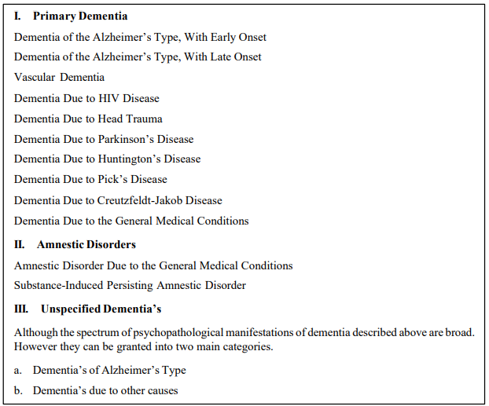

Slide 5
ALZHEIMER’S
Alzeimers disease is primary degenerative cerebral disease of unknown etiology, with characteristic neuropathological and neurochemical features.
The disease is usually insidious in onset to develop, slowly but steadily over a period of years.
This period can be short or considerably long.
The onset can be in any age group but the incidence is higher in later life.
In cases with early onset of disease there is likelihood of a family history of similar dementia, a more rapid course and prominence of features of parietal or temporal lobe damage, including aphasia or dysprexia. In cases with a late onset, the course tends to be slower and cognitive impairment is more marked.

Slide 6
Early Detection and Screening of Alzheimer’s disease
As the onset of the disease is insidious and slow and progressive, the early detection of the disease is important.
Screening has been defined as the presumptive identification of unrecognized disease or defect by the application of tests, examinations or other procedures, which can be applied rapidly. A screening test sorts out apparently well persons, who probably have a disease from those who probably do not. A screening test is not intended to be diagnostic. Hence the first step is to administer a simple test, which can measure cognitive impairment by a Mental Status Questionnaire and the short portable Mental Status Questionnaire.
The second stage case identification includes, diagnostic procedures, which include a number of standardized psychogeriatric interviews which are based on clinical diagnostic concepts but also make use of scores derived from rating scales. The lack of detailed diagnostic criteria is specially significant in early case identification, since without a clear definition there can be no reliable case identification.
The third stage of screening include assessment of associated impairments and disabilities. A comprehensive screening and diagnosis cannot be confined to psychiatric diagnosis and treatment alone. For this reason, a multidimensional concept is indicated in assessment as well as in care programme. The techniques of multi level assessment developed in recent years appear to provide the most suitable working tools for screening and diagnosis.

Slide 7
What happens to the Elderly patient?
Onset is insidious, usually after 65, though sporadic cases can occur earlier. The disease runs a progressive course. The initial symptoms are impairment of memory and subtle personality changes, usually reported by the family members, the patient often being unaware of this symptoms.
Mild anxiety and depressive symptoms are frequently present in the early stages. In Alzheimers disease there is progressively increasing impairment of memory and other intellectual abilities. Although the problems may initially be manifested in such ways as forgetfulness, poor judgement or difficulty making calculations and handling money, the cognitive losses ultimately leave the person confused, disoriented and incapable of communicating normally.
Commonly personality changes are there, which may range from apathy and social withdrawal to quarrelsomeness and agitation and frequently display various emotional reactions to their illness, such as anxiety, depression or suspiciousness, other symptoms, such as disturbed sleep, hallucinations and delusional ideas or tendency to wander aimlessly are also common. Overtime even customary daily activities are lost.
Eventually they may lose elementary physical abilities such as bladder and bowel control and become totally dependent on others to provide for their personal needs and safety. Urinary and faecal incontinence may occur at later stages. Seizures, coma and death are the final outcome. Suspiciousness, obsessiveness, irritability and outbursts of anger may also appear in the early stages of illness. These are followed by disturbances in orientation and judgement, and may lead to purposeless wandering. The patient may be found far away from home in a dazed condition.
Neurological defects, such as gait disturbances, aphasia, apraxia and agnosia may occur. The peculiar tragedy of Alzheimer’s disease and other related dementia’s is that they dissolve the mind and steal the humanity of the victim, leaving a body from which the person has largely been removed. Simultaneously dementia’s devastate lives of spouses and other family members, who must endure their deterioration of their loved ones and the loss of the person and relationship that is implied. Caregivers face the agony of seeing their loved ones minds and personalities disappear from bodies that may frequently remain otherwise healthy and shoulder heaving physical, social and emotional burdens over a prolonged period of time. The effects on the afflicted families are personally profound and financially devastating.

Slide 8
Treatment and Care
There is no specific drug treatment.
However treatment guidelines include the following principles:
First step in management is to find out the cause, if any. A complete medical history and thorough physical examination should be carried out. CT scan is helpful in confirming the diagnosis and also in finding the cause in some cases such as space occupying lesions. Other relevant investigations should be done, for example, thyroid function tests, if hypothyroidism is suspected. If a treatable cause is found, specific treatment is started, e.g., thyroid replacement therapy for hypothyroidism, and neurosurgical treatment for subdural haematoma and normal pressure hydrocephalus.
General treatment consists of good nutritious diet, nursing care, family support and attention to visual and auditory deficits, if any. If any other physical ailments, such as urinary tract problems, cardiac or pulmonary disorders are present, specific treatment should be given. It is essential to counsel the family regarding nature of illness for its effective management.
Family has a very important role to play in management of dementia. Considering the breaking of joint families in India and increase in the elderly living alone due to their children moving away, institutions for the elderly such as old age homes, day care centers, etc., are needed especially for the elderly ill, where they can be taken care of. Family members need the opportunity to receive a clear diagnosis and explanation of the problem and assistance in assessing their changing care need as the disease progresses and the care demand on the family increase. Care begins in the home and in the community.
The challenge is in determining when homecare becomes the option of choice or when nursing home care is necessary. Both forms of care are essential and mutually supportive components of long-term care, neither can substitute for the other. Medical care involves symptomatic management of treating both psychological and physical symptoms and treatment of medical comorbidity when present.
Antianxiety and antidepressant drugs if anxiety and depressive symptoms are present. Risperidone or thioridazine are effective in controlling agitation, if present. The use of vitamins like B and E have been found useful in some cases as these vitamins help in neutralizing toxic elements in the body. Tacrine a cholinesterase inhibitor has been found to produce significant improvement in 20 to 25 % of patients with Alzheimers disease. Similarly RIVASTIGMINE can delay the progression of Alzheimer disease.
Balanced diet and proper fluid management is important part of treatment. Treatment of behavioural manifestations of Alzheimer’s is helpful. As a part of care, personal hygiene and toilet habits form an integral part of management.

